Slide 1


Anton Kliabeka
2022-05-09
LinkedIn: https://www.linkedin.com/in/anton-kliabeka-69a082155/

Slide 2

Outline
Executive Summary
Introduction
Methodology
Results
Conclusion
Appendix

Slide 3
Executive Summary
Summary of methodologies:
Data collection;
Data wrangling;
EDA with data visualization;
EDA with SQL;
Building an interactive map with Folium;
Building a Dashboard with Plotly Dash;
Predictive analysis (Classification);
Summary of all results:
EDA results;
Analytics in screenshots;
Predictive analysis results;

Slide 4
Introduction
Project background and context:
The commercial space age is here, companies are making space travel affordable for everyone;
Perhaps the most successful is SpaceX;
SpaceX launch costs about 65$ million, the others - about 165$ million.
Much of the savings is because SpaceX can reuse the first stage - SpaceX's Falcon 9 can recover the first stage.
The first stage is quite large (much larger than the second stage) and expensive, and does most of the work.

Slide 5
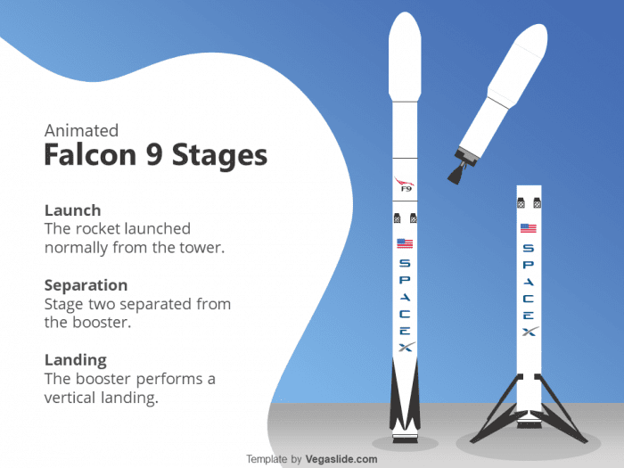
Introduction
Project background and context:

Slide 6
Introduction
Project goal:
To answer the question "Is it possible to determine if the first stage will land?" with the help of SpaceX's Falcon 9 launch data. The answer will help to determine the cost of a launch.

Slide 7

Section 1

Slide 8
Methodology
Data collection methodology:
SpaceX REST API;
Web scraping related Wikipedia pages;
Perform data wrangling:
Converting Landing Outcomes into Classes (either 0 or 1);
Applying One-Hot Encoding technique to categorical predictors;
Perform exploratory data analysis (EDA) using visualization and SQL:
Using different types of charts and diagrams, and SQL queries to show relationship between variable, to reveal patterns of the data, and to understand the data;
Perform interactive visual analytics using Folium and Plotly Dash;
Perform predictive analysis using classification models:
Standardizing data, splitting data into training and test sets, hyperparameters tuning, evaluation and finding the method performs best;

Slide 9
Data Collection
SpaceX REST API lets us get data about launches, including information about the rocket used, payload delivered, launch specifications, landing specifications, and landing outcome;
Web scraping related Wikipedia pages - request a get response from Wikipedia and using the Python BeautifulSoup package to web scrape some HTML tables, parsing the data from those tables and convert them into a Pandas datframe for further visualization and analysis;
Transform raw data into a clean dataset which provides meaningful data;
Filter the data to have only Falcon 9 launches;
Dealing with NULL values;

Slide 10
Data Collection – General Flowcharts
SpaceX REST API
Use
SpaceX API
To get the response in the form of a JSON
Convert JSON into a flat table
Web Scraping
Get HTML response from Wikipedia
Convert raw data into a flat table
Use
BeautifulSoup
to web scrape
HTML tables

Slide 11
Data Collection – SpaceX API
1. Get response from the API
3. Get clean dataset which provides meaningful data
import requests
static_json_url = "https://cf-courses-data.s3.us.cloud-object-storage.appdomain.cloud/IBM-DS0321EN-SkillsNetwork/datasets/API_call_spacex_api.json"
Response_static = requests.get(static_json_url)
# using custom functions
getLaunchSite(data)
getPayloadData(data)
getCoreData(data)
# create a dictionary and fill it with data
launch_dict = {...}
df_launch_data = pd.DataFrame(data = launch_dict)
# filter the dataframe to only include Falcon 9 launches
data_falcon9 = df_launch_data[
df_launch_data['BoosterVersion'] == 'Falcon 9'
].reset_index(drop = True)
# dealing with null values
Import numpy as np
PayloadMass_mean = data_falcon9['PayloadMass'].mean()
data_falcon9['PayloadMass'].replace(np.nan, PayloadMass_mean, inplace = True)
# save as csv
data_falcon9.to_csv('falcon9_dataset_part_1.csv', index = False)
2. Import to a Pandas dataframe
import pandas as pd
df_static = pd.json_normalize(response_static.json())
GitHub URL of the completed SpaceX API calls notebook;

Slide 12
Data Collection – Web Scraping
1. Get response from Wikipedia
3. create a data frame by parsing the launch HTML tables
import requests
static_url = "https://en.wikipedia.org/w/index.php?title=List_of_Falcon_9_and_Falcon_Heavy_launches&oldid=1027686922"
Response_static = requests.get(static_url)
import pandas as pd
# extract records from table rows
launch_dict = dict.fromkeys(column_names)
extracted_row = 0
for table_number, table in enumerate(data_bs.find_all('table', "wikitable plainrowheaders collapsible")):
# get table row
for rows in table.find_all("tr"):
# check if first table heading is a number corresponding to a lch number
if rows.th:
if rows.th.string:
flight_number = rows.th.string.strip()
flag = flight_number.isdigit()
else:
flag = False
{…some logic...}
# save data
df = pd.DataFrame(launch_dict)
df.to_csv('spacex_web_scraped.csv', index = False)
2. Use BeautifulSoup to web scrape HTML tables
from bs4 import BeautifulSoup as bs
data_bs = bs(static_response.text, 'html5lib')
# find all objects with type 'table'
html_tables = data_bs.find_all('table')
# exctarct column names
column_names = []
for row in first_launch_table.find_all('th'):
name = extract_column_from_header(row)
if name and len(name) > 0:
column_names.append(name)
GitHub URL of the completed Web Scraping notebook;

Slide 13
Data Wrangling
Appling One-Hot Encoding to categorical columns;
Convert Landing Outcomes to Classes (either 0 or 1):
0 is a bad outcome, that is, the booster did not land;
1 is a good outcome, that is, the booster did land.
1. Create dummy variables to categorical columns
2. Converting Landing Outcomes into Classes (0 or 1)
# read data
...
# Create dummy variables to categorical columns
# columnslist - list of categorical columns
features_one_hot.drop(columns = ['GridFins', 'Reused', 'Legs'], inplace = True)
for column in columnslist:
features_one_hot = pd.concat(
[
features_one_hot,
pd.get_dummies(features[column], prefix = column)
], axis = 1
)
# read data
...
# create classification variable from the "Outcome" column
landing_class = [0 if item in bad_outcomes else 1 for item in df['Outcome']]
df['Class'] = landing_class
GitHub URL 1 and URL 2 of a data wrangling related notebooks;

Slide 14
EDA with Data Visualization
Plotted charts:
Bar chart "Success Rate by Orbit Type" (shows relationship between success rate of each Orbit Type);
Linear Plot "Success yearly trend" (shows the success rate and its trend since 2013);
Scatter Plots (How much one variable is affected by another):
- "Flight Number" vs "Payload Mass";
- "Flight Number" vs "Launch Site";
- "Launch Site" vs "Payload Mass";
- "Flight Number" vs "Orbit Type";
- "Payload" vs "Orbit Type";
GitHub URL completed EDA notebook with data visualization;

Slide 15
EDA with SQL
List of performed SQL queries to understand the dataset:
Names of the unique launch sites in the space mission;
5 records where launch sites begin with the string 'CCA';
Total payload mass carried by boosters launched by NASA (CRS);
Average payload mass carried by booster version F9 v1.1;
The date when the first successful landing outcome in ground pad was achieved;
Names of the boosters which have success in drone ship and have payload mass greater than 4000 but less than 6000;
Total number of successful and failure mission outcomes;
Names of the Booster Versions which have carried the maximum payload mass using a subquery;
Failed Landing Outcomes in drone ship, their booster versions, and launch site names for in year 2015;
Rank the count of landing outcomes (such as Failure (drone ship) or Success (ground pad)) between the date 2010-06-04 and 2017-03-20, in descending order;
GitHub URL of completed EDA with SQL notebook;

Slide 16
Build an Interactive Map with Folium
The launch success rate may depend on the location and proximities of a launch site, i.e., the initial position of rocket trajectories. Finding an optimal location for building a launch site certainly involves many factors and we could discover some of the factors by analyzing the existing launch site locations;
Map objects added to a folium map:
All launch sites – Circle objects;
Success/failed launches for each site – Marker Cluster objects;
The distances between a launch site to its proximities – Line objects;
GitHub URL of completed interactive map with Folium map;

Slide 17
Build a Dashboard with Plotly Dash
Plotted charts used in the dashboard:
Scatter Plot showing relationship between Outcome and Payload Mass for different Booster Versions. It shows the correlation between payload mass and launch success;
Pie Chart showing:
- Total successful launches count for all sites;
- Success vs. Failed counts for a specific site;
GitHub URL of Plotly Dash lab source code;

Slide 18
Predictive Analysis (Classification)
PREPARATIONS:
Load and Transform data (using pandas and numpy);
Split into train and test (using scikit-learn);
Choose ML algorithms;
HYPERPARAMETERS TUNING:
Use GridSearchCV to choose the best set of parameters;
Fit train dataset to train models;
If the quality of the model is not good enough!
PERFOMANCE EVALUATION:
Check the Accuracy Score of each model;
Check Confusion Matrix;
FINDING THE BEST PERFORMING MODEL:
A model with the best Accuracy Score is considered as the best performing model;
GitHub URL of completed predictive analysis lab;

Slide 19
Results
Exploratory data analysis results
Interactive analytics demo in screenshots
Predictive analysis results

Slide 20

Section 2

Slide 21
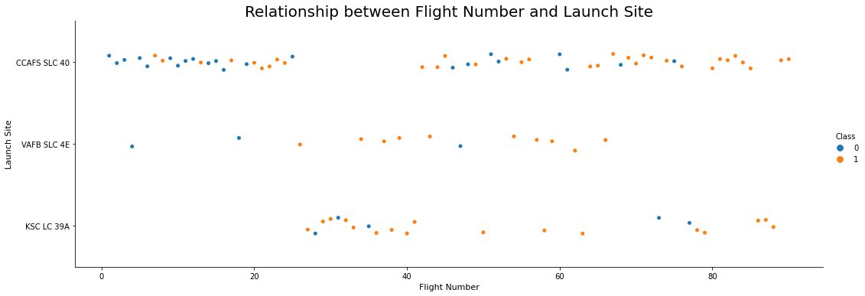
Flight Number vs. Launch Site
Different Launch Sites have different successful rate;
First 35 Flight Numbers were not very successful;
Starting from Flight Number 35 the successful tate shows strong improvement in general;

Slide 22
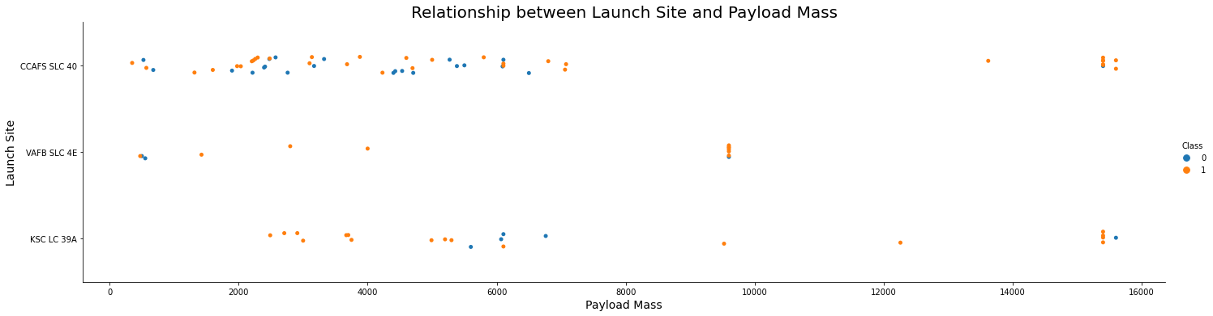
Payload vs. Launch Site
It feels like the greater the payload mass, the higher the success rate, but there is no a clear pattern to be found to say for sure if a success launch is dependent on the combination of a launch site and payload mass;

Slide 23
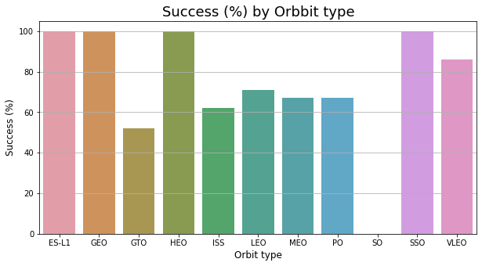
Success Rate vs. Orbit Type
Orbit types ES-L1 (1), GEO (1), HEO (1), SSO (5) have the highest success % - 100%;
Orbit type SO (1) has the lowest success % - 0%;
Orbit types' success % with 5 or more cases by success %:
SSO (5) - 100%;
VLEO(14) - 86%;
LEO (7) - 71,5%;
PO (9) - 67%;
ISS (21) - 62%;
GTO (27) - 52%;

Slide 24
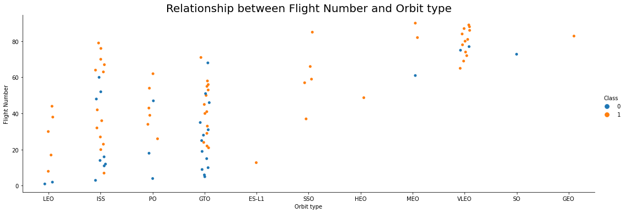
Flight Number vs. Orbit Type
In the LEO orbit the success appears to be related to the number of flights;
In the GTO orbit there is no relationship between flight number;

Slide 25
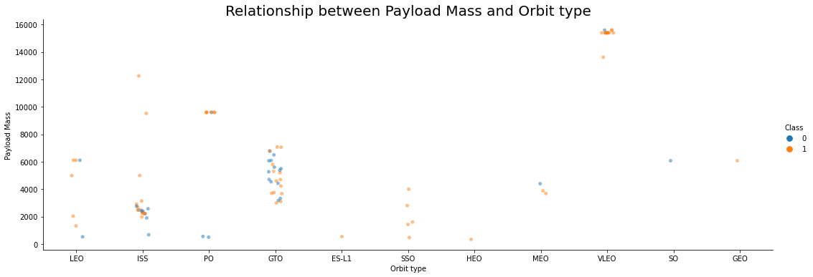
Payload vs. Orbit Type
With heavy payloads the positive landing rates are higher for Polar, LEO and ISS;
For the GTO it is not possible to distinguish effect of the payload mass;

Slide 26
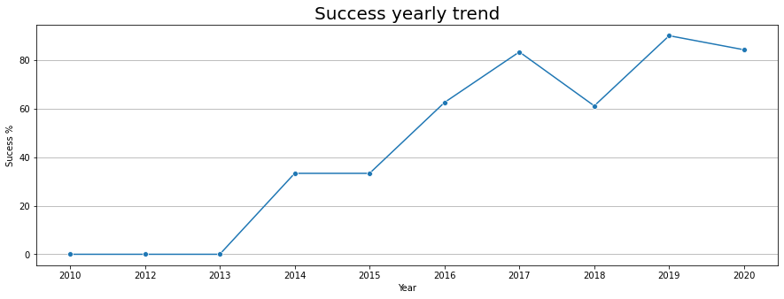
Launch Success Yearly Trend
The general trend of the success rate kept increasing since 2013 till 2020 with a drawdown in 2018;

Slide 27
All Launch Site Names
RESULT:
('CCAFS LC-40',) ('VAFB SLC-4E',) ('KSC LC-39A',) ('CCAFS SLC-40',)
QUERY:
select distinct(Launch_Site)
from Spacex;
Display the names of the unique launch sites in the space mission;
The select DISTINCT statement is used to return only distinct (different) values;

Slide 28
Launch Site Names Begin with 'CCA'
QUERY:
select *
from Spacex
where Launch_Site like ('CCA%')
limit 5;
Display 5 records where launch sites begin with the string 'CCA';
The LIMIT clause is used to select a limited number of records;
The LIKE operator is used in a WHERE clause to search for a specified pattern in a column;
RESULT:
('04-06-2010', '18:45:00', 'F9 v1.0 B0003', 'CCAFS LC-40', 'Dragon Spacecraft Qualification Unit', 0, 'LEO', 'SpaceX', 'Success', 'Failure (parachute)') ('08-12-2010', '15:43:00', 'F9 v1.0 B0004', 'CCAFS LC-40', 'Dragon demo flight C1, two CubeSats, barrel of Brouere cheese', 0, 'LEO (ISS)', 'NASA (COTS) NRO', 'Success', 'Failure (parachute)') ('22-05-2012', '07:44:00', 'F9 v1.0 B0005', 'CCAFS LC-40', 'Dragon demo flight C2', 525, 'LEO (ISS)', 'NASA (COTS)', 'Success', 'No attempt') ('08-10-2012', '00:35:00', 'F9 v1.0 B0006', 'CCAFS LC-40', 'SpaceX CRS-1', 500, 'LEO (ISS)', 'NASA (CRS)', 'Success', 'No attempt') ('01-03-2013', '15:10:00', 'F9 v1.0 B0007', 'CCAFS LC-40', 'SpaceX CRS-2', 677, 'LEO (ISS)', 'NASA (CRS)', 'Success', 'No attempt')

Slide 29
Total Payload Mass
QUERY:
select Customer, sum(PAYLOAD_MASS__KG_)
from Spacex
where Customer = 'NASA (CRS)';
RESULT:
('NASA (CRS)', 45596)
Display the total payload mass carried by boosters launched by NASA (CRS);
The SUM() function returns the total sum of a numeric column;

Slide 30
Average Payload Mass by F9 v1.1
QUERY:
select Booster_Version, avg(PAYLOAD_MASS__KG_)
from Spacex
where Booster_Version = 'F9 v1.1';
RESULT:
('F9 v1.1', 2928.4)
Display average payload mass carried by booster version F9 v1.1;
The AVG() function returns the average value of a numeric column;

Slide 31
First Successful Ground Landing Date
QUERY:
select min(date(substr(Date, 7) || "-" || substr(Date, 4, 2) || "-" || substr(Date, 1, 2)))
from Spacex
where landing__outcome = 'Success (ground pad)'
List the date when the first successful landing outcome in ground pad was acheived;
The MIN() function returns the smallest value of the selected column;
The SUBSTR() function extracts a substring from a string (starting at any position);
RESULT:
('2015-12-22')

Slide 32
Successful Drone Ship Landing with Payload between 4000 and 6000
QUERY:
select distinct(Booster_Version)
from Spacex
where 1 = 1
and upper(Landing__Outcome) like ('SUCCESS%')
and upper(Landing__Outcome) like ('%DRONE SHIP%')
and PAYLOAD_MASS__KG_ > 4000
and PAYLOAD_MASS__KG_ < 6000;
RESULT:
('F9 FT B1022',) ('F9 FT B1026',) ('F9 FT B1021.2',) ('F9 FT B1031.2',)
List the names of the boosters which have success in drone ship and have payload mass greater than 4000 but less than 6000;
The 1=1 is alway True (google it for more info);
The UPPER() function converts a string to upper-case;

Slide 33
Total Number of Successful and Failure Mission Outcomes
QUERY:
select 'Success' as outcom, count(*) as item_cnt
from Spacex
where upper(Mission_Outcome) like ('SUCCESS%')
union
select 'Failure' as outcom, count(*) as item_cnt
from Spacex
where upper(Mission_Outcome) like ('FAILURE%');
RESULT:
('Success', 100) ('Failure', 1)
List the total number of successful and failure mission outcomes;
The UNION operator is used to combine the result-set of two or more SELECT statements;

Slide 34
Boosters Carried Maximum Payload
QUERY:
select distinct(Booster_Version), PAYLOAD_MASS__KG_
from Spacex
where PAYLOAD_MASS__KG_ = (
select max(PAYLOAD_MASS__KG_)
from Spacex
);
RESULT:
('F9 B5 B1048.4', 15600) ('F9 B5 B1049.4', 15600) ('F9 B5 B1051.3', 15600) ('F9 B5 B1056.4', 15600) ('F9 B5 B1048.5', 15600) ('F9 B5 B1051.4', 15600) ('F9 B5 B1049.5', 15600) ('F9 B5 B1060.2 ', 15600) ('F9 B5 B1058.3 ', 15600) ('F9 B5 B1051.6', 15600) ('F9 B5 B1060.3', 15600) ('F9 B5 B1049.7 ', 15600)
List the names of the booster_versions which have carried the maximum payload mass;
A Subquery or Inner query or a Nested query is a query within another SQL query and embedded within the WHERE clause;
The MAX() function returns the largest value of the selected column;

Slide 35
2015 Launch Records
QUERY:
select Landing__Outcome, Booster_Version, Launch_Site, date
from Spacex
where 1 = 1
and upper(Landing__Outcome) like ('%DRONE SHIP%')
and upper(Landing__Outcome) like ('FAILURE%')
and date like '%2015';
List the failed landing_outcomes in drone ship, their booster versions, and launch site names for in year 2015;
RESULT:
('Failure (drone ship)', 'F9 v1.1 B1012', 'CCAFS LC-40', '10-01-2015') ('Failure (drone ship)', 'F9 v1.1 B1015', 'CCAFS LC-40', '14-04-2015')

Slide 36
Rank Landing Outcomes Between 2010-06-04 and 2017-03-20
QUERY:
select Landing__Outcome, count(*) as Landing__Outcome_count
from Spacex
where 1 = 1
and date(substr(Date, 7) || "-" || substr(Date, 4, 2) || "-" || substr(Date, 1, 2)) between '2010-06-04' and '2017-03-20'
group by Landing__Outcome
order by Landing__Outcome_count desc;
RESULT:
('No attempt', 10) ('Success (drone ship)', 5) ('Failure (drone ship)', 5) ('Success (ground pad)', 3) ('Controlled (ocean)', 3) ('Uncontrolled (ocean)', 2) ('Failure (parachute)', 2) ('Precluded (drone ship)', 1)
Rank the count of landing outcomes between the date 2010-06-04 and 2017-03-20, in descending order;
The BETWEEN operator selects values within a given range;
The GROUP BY statement groups rows that have the same values into summary rows;
The ORDER BY keyword is used to sort the result-set in ascending or descending order;
To sort the records in descending order, use the DESC keyword;

Slide 37

Section 3

Slide 38
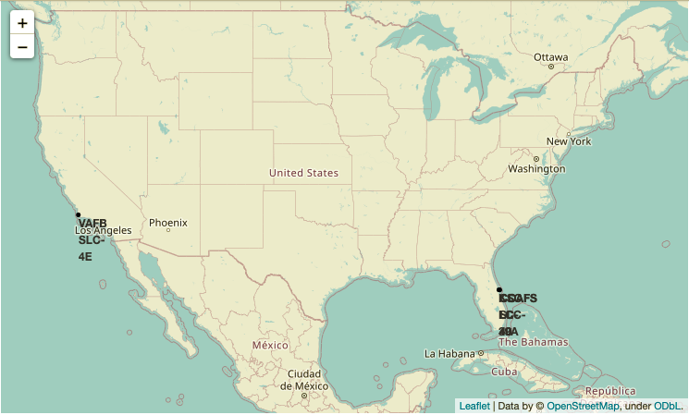
All launch sites on a map
We see that the SpaceX launch sites are located in the US coasts - Florida and California;

Slide 39
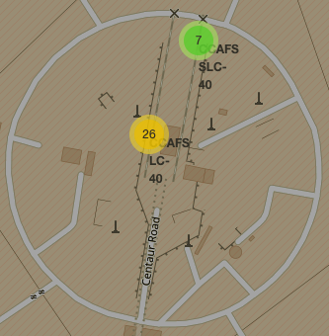
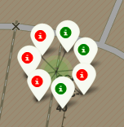
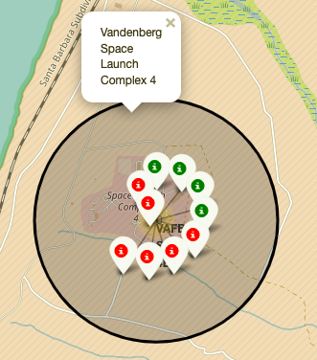
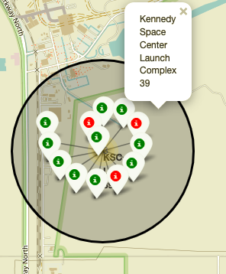
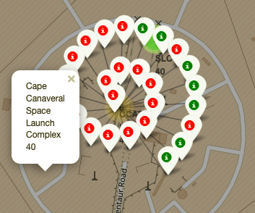
Colour Labelled Markers
California Launch Site
Green Marker - successful launch;
Red Marker - unsuccessful launch;
Florida Launch Sites

Slide 40
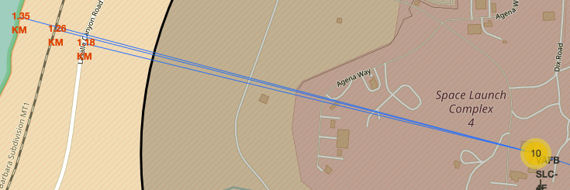
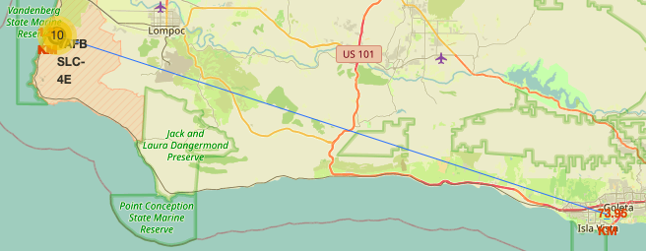
Launch Site distances to landmarks (VAFB SLC-4E as a reference)
Q1: Are launch sites in close proximity to railways?
A1: Yes, they are (max distance is less than 2 KM);
Q2: Are launch sites in close proximity to highways?
A2: Yes, they are (max distance is less than 1.5 KM);
Q3: Are launch sites in close proximity to coastline?
Yes, they are (max distance is less than 1.5 KM);
Q4: Do launch sites keep certain distance away from cities?
A4: If the "certain distance" is some distance higher than 50 KM, then yes, they do;

Slide 41

Section 4

Slide 42
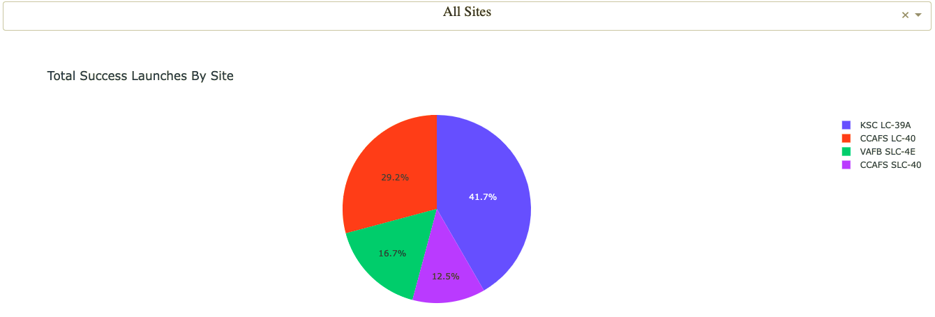
SpaceX Launch Records Dashboard
KSC LC-39A has the highest number of successful launches from all the sites;

Slide 43
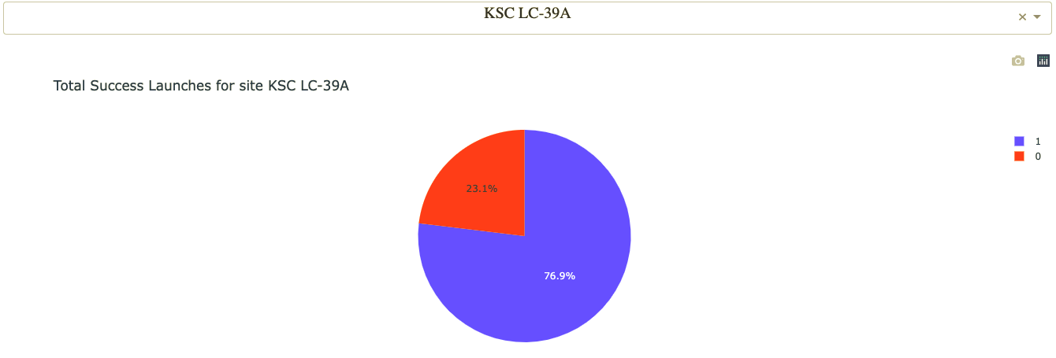
SpaceX Launch Records Dashboard
KSC LC-39A achieves a 76.9% success rate;

Slide 44
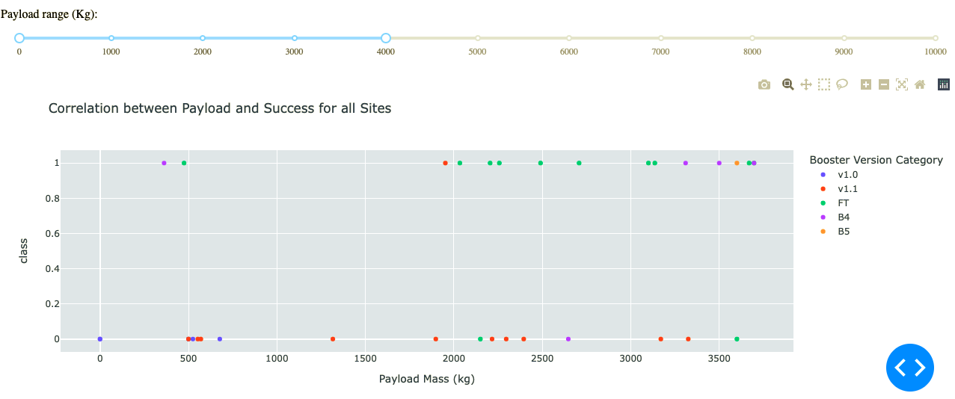
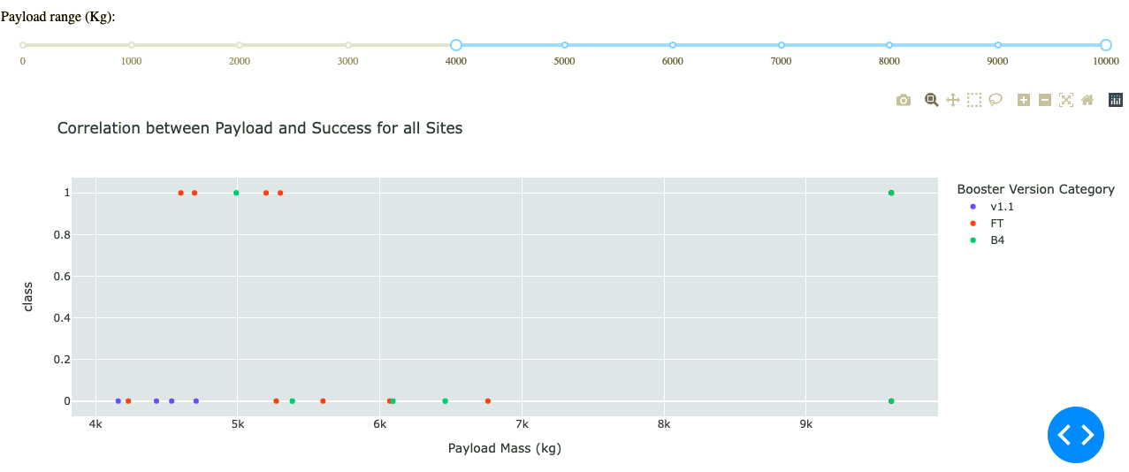
SpaceX Launch Records Dashboard
The success rates for cases with Payload Mass 0 kg – 4000 kg is higher than for cases with Payload Mass 4000 kg – 10000kg (for all sites);

Slide 45

Section 5

Slide 46
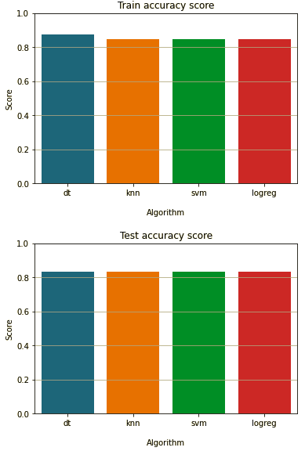
Classification Accuracy
In this case the Test accuracy is the same for all the algorithms – 0.83. Nevertheless I've decided to choose a Decision Tree algorithm, because its Train accuracy is a little bit higher – 0.875;
The DT classifier best parameters (according to the GridSearchCV results):
{
'criterion': 'gini',
'max_depth': 4,
'max_features': 'sqrt',
'min_samples_leaf': 4,
'min_samples_split': 2,
'splitter': 'random'
}

Slide 47
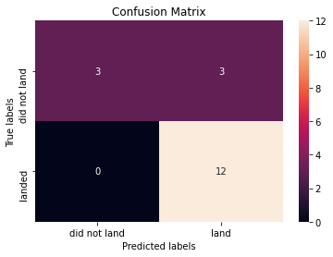
Confusion Matrix
According to the Confusion Matrix, the DT algorithm can distinguish "land" pretty good, while there is a problem with "did not land" cases – Type I error. We can try to solve the problem by changing a cut off value (default is 0.5), applying a bagging technique, or by adding more data;

Slide 48
Conclusions
The general trend of the success rate kept increasing since 2013;
Orbit types ES-L1, GEO, HEO, SSO have the highest success % - 100%;
All the launch sites keep certain distance from cities and are in close proximity to railways, highways, coastline;
Launch site KSC LC-39A has the highest number of successful launches from all the sites;
The success rates of Low weighted payloads (0-4000 kg) is higher than for heavier payloads (4000-10000 kg) among all sites;
Decision Tree Classifier may be the best algorithm in our case, but there is still some space for making an algorithm's performance better;

Slide 49
Appendix
SQLite

Slide 50

SQLite
SQLite is an embedded SQL database engine. Unlike most other SQL databases, SQLite does not have a separate server process. SQLite reads and writes directly to ordinary disk files. A complete SQL database with multiple tables, indices, triggers, and views, is contained in a single disk file.
# import libraries
import sqlite3
from sqlite3 import Error
<- saved database
# create connection
def sql_connection():
try:
connection = sqlite3.connect('sqlite.db')
return connection
except Error as er:
print(er)
# fetch data
def sql_fetch(connection, select):
# create a cursor
cursor = connection.cursor()
cursor.execute(select)
for row in cursor.fetchall():
print(row)
# run query
select_col = """
select distinct(Launch_Site)
from Spacex;
"""
sql_fetch(sql_connection(), select_col)
# output
('CCAFS LC-40',) ('VAFB SLC-4E',) ('KSC LC-39A',) ('CCAFS SLC-40',)

Slide 51


